Slide 1

CMR COLLEGE OF ENGINEERING & TECHNOLOGY
Kandlakoya, Medchal, Hyderabad – 501401
Department of Computer Science and Engineering
Enhancement of Decision Tree for Software Cost Estimation
Batch No:06
Name of the student:
K.Dhathri Guptha - 20H51A05J9
B.Manichandana - 20H51A05N0
M.Laya - 20H51A05P4
Under esteemed guidance of
Guide Name: Dr.V.Venkataiah
Associate Professor of CSE &
Additional Controller Of Examination
Batch: 2020-2024 Major Project Phase 1

Slide 2
Outline
Abstract
Introduction
Research Objective
Problem Definition
Scope of the Project
Literature Review
Implementation of Existing system
Conclusion
References
Notes:
2

Slide 3
Abstract
Notes:
3

Slide 4
ABSTRACT
Effort estimation of the software is one of the biggest problems faced by software industry. It includes planning, supervising projects, analysing viability of the system development, preparing proposals and proposals presentation to clients and among this estimation of the effort for planning is one of the most critical responsibilities. It is necessary to have good effort estimation in order to conduct well budget. The accuracy of the effort estimation of software projects is vital for the competitiveness of software companies. For the forecasting of software effort, it is important to select the correct software effort estimation techniques. Numbers of have been proposed like algorithm, non-algorithm, Machine Learning algorithms and so on.

Slide 5
Generally , Decision Trees have drawn the attention of the researchers and changed the direction of Effort Estimation towards computational intelligence . In this project we are using decision tree concept which is a simple yet powerful approach and it can be taken as the base for Random Forest, which is known as a group of decision trees. Decision Trees facing data over fitting problem. To overcome this problem enhancement of Decision Tree with ensemble method proposed in this project and also For evaluate performance of this proposed method using COCOMO 81 dataset or International Software Benchmarking Standard Groups (ISBSG) data set and to evaluation metrics like Mean Magnitude Relative Error (MMRE) and Root Mean Square Error (RMSE). Comparative study shows that proposed technique, achieves better results than previous techniques.

Slide 6
INTRODUCTION
Notes:
6

Slide 7
Introduction
Software Cost Estimation (SCE) is a process of predicting the amount of effort, time and cost, for complete the software development project.
Effort is a unit of labor cost that is expressed in terms of person-months and it depends upon both the size as well as the complexity of the software project.
The size of the project is usually measured as Kilo Lines of Code (KLOC) and the complexity is given by the Effort adjustment Factor(EAF).
Software cost is dependent on several cost factors such as the level of reliability desired, the software tools used, the programmers capability and so on.
All these factors contribute to the inherent uncertainty associated with software cost estimation.
To cope with such factors, need cost predictions.
Software cost predictions:
Planning
Supervising projects
Analyzing the viability of system development
Notes:
7

Slide 8
Preparing bids
Proposals presentation to clients
Uses of Software Cost Estimation:
It can help in the classification and prioritization of development projects within the context of a larger project plan.
It can be used to find out how much amount of money to spent in the project.
It can be used to measure the impact of changes and to aid in reorganization.
Customers anticipate that actual development costs will be comparable to those forecasted.

Slide 9
Research Objective
Notes:
9

Slide 10
Research objective
Our research aims to develop a software cost estimation model using decision trees.
We evaluate the model's performance, focusing on accuracy and efficiency.
Ultimately, we intend to showcase the potential of machine learning in the context of software cost estimation.

Slide 11
Problem Definition
Notes:
11

Slide 12
Problem Definition
Traditional software cost estimation methods lack accuracy and reliability.
The need for more effective and data-driven approaches is evident.
That the reason we come up with this idea .In this project , the main aim is to improve software effort estimation by constructing a decision tree that makes use of several machine learning methods on software effort estimation datasets .
In this project using COCOMO 81 dataset , we are estimating and calculate the accurate data as compare with other approaches .

Slide 13
Scope of the Project
Notes:
13

Slide 14
Scope of the Project
The scope of our project about human resources required to develop of the project.

Slide 15
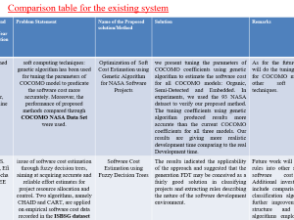
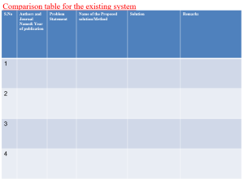
Literature Review
Notes:
15

Slide 16
Comparison table for the existing system
S.No | Authors and Journal Name& Year of publication | Problem Statement | Name of the Proposed solution/Method | Solution | Remarks
1 | Mohammed Algabri ,Fahman Saeed, Hassan Mathkour, Nejmeddine Tagoug ,IEEE & 2015. | soft computing techniques: genetic algorithm has been used for tuning the parameters of COCOMO model to predicate the software cost more accurately. Moreover, the performance of proposed methods compared through COCOMO NASA Data Set were used. | Optimization of Soft Cost Estimation using Genetic Algorithm for NASA Software Projects | we present tuning the parameters of COCOMO coefficients using genetic algorithm to estimate the software cost for all COCOMO models: Organic, Semi-Detected and Embedded. In experiments, we used the 93 NASA dataset to verify our proposed method. The tuning coefficients using genetic algorithm produced results more accurate than the current COCOMO coefficients for all three models. Our results are giving more realistic development time comparing to the real Development time. | As for the future work, we will do the tuning coefficients for COCOMO models using other soft computing techniques.
2 | Andreas S. Andreou, Efi Papatheocharous ,IEEE &2008. | issue of software cost estimation through fuzzy decision trees, aiming at acquiring accurate and reliable effort estimates for project resource allocation and control. Two algorithms, namely CHAID and CART, are applied on empirical software cost data recorded in the ISBSG dataset repository. Approximately 1000 project data records are selected for analysis and experimentation, with fuzzy decision trees instances being generated and evaluated based on prediction accuracy. | Software Cost Estimation using Fuzzy Decision Trees | The results indicated the applicability of the approach and suggested that the generation FDT may be conceived as a fairly good solution in classifying projects and extracting rules describing the nature of the software development environment. | Future work will utilize these rules into other structures or software cost models. Additional investigation will include comparison of other classification algorithms and further improvement on the structure and on the algorithms employed in the experiments.
3 | 4th International Conference on Computer Science &Education, IEEE&2009. | In order to obtain the software effort, we are coming with an estimating method for software effort based on function point. It helps to estimate software effort more accurately without considering the languages or developing environment we choose. | Estimation of software projects effort based on function point | we propose an estimating method for software effort based on function point to Scale increasing in applications and a variety of programming languages using at the same time, manual measurement based on the LOC (Line of Code) cannot meet the estimating requirements. The emergence of Function Point resolves these difficult issues | We can get more accurate result by using optimization techniques than functional points .
4 | Goldie Gabrani , Neha Saini ,IEEE & 2016. | We focuses on the comparative study of various non-algorithmic techniques used for estimating the software effort by empirical evaluation of five different evolutionary learning algorithms using Desharnais dataset , Maxwell dataset and Miyazaki94 dataset. | Effort Estimation Models Using Evolutionary Learning Algorithms for Software Development | The accuracy of these algorithms is found out and the behavior of these algorithms is analyzed with respect to the size and the type of data. All the five techniques are applied on three different datasets and various parameters such as MMRE, PRED(25), PRED(50), PRED(75) are calculated. The proposed results are compared to other machine learning methods like SVR, ANFIS etc. The results show that evolutionary learning algorithms give more accurate results than machine learning algorithms. | In the future, this empirical study can be done for some industrial software. Further, we can apply other evolutionary algorithms like bacterial foraging and particle swarm optimization on the same datasets and evaluate if there is any performance improvement in results or not. This study can be repeated again for other new techniques until we find a unique technique which can give accurate and correct estimation for all types of datasets.

Slide 17
Comparison table for the existing system
S.No | Authors and Journal Name& Year of publication | Problem Statement | Name of the Proposed solution/Method by authors | Solution | Remarks
5 | Dr. Haitham Hamza , Dr. Amr Kamel , Khaled Shams, IEEE & 2013. | We provides an overview on the use Artificial Neural Networks methods to estimate the development effort for software development projects, There are several ANNs methods that are used in software estimation, bellow are the mostly common ANNs as per this survey: 1.Feed-forward neural network 2. Recurrent neural networks 3. Radial basis function (RBF) network 4. Neuro-fuzzy networks. | Software Effort Estimation using Artificial Neural Networks: A Survey of the Current Practices | Choosing the right ANNs methods, is important to get accurate estimation, as per this survey: in case of noisy data, Feed forward neural network using Levenberg-Marquardt, performs better than Feed-forward back-propagation method. | The Feed forward techniques need data filtering techniques, to prevent divergence, so it is important to have data noise filtering The radial basis function is the most suitable for noisy data.
6 | Iman Attar Zadeh, Siew Hock Ow , IEEE & 2010. | Understanding and calculation of models based on historical data are difficult due to inherent complex relationships between the related attributes, are unable to handle categorical data as well as lack of reasoning capabilities. Besides, attributes and relationships used to estimate software development effort could change over time and differ for software development environments. In order to address and overcome to these problems, a new model with accurate estimation will be considerable. Experiments were done by taking two datasets, first one was original data from COCOMO dataset and second one was artificial dataset. | Proposing a New Software Cost Estimation Model Based on Artificial Neural Networks | The proposed neural networks model showed better software effort estimates in view of the MMRE, Pred(0.25) evaluation criteria as compared to the traditional COCOMO. The above mentioned results demonstrate that applying neural networks method to the software effort estimation is a feasible approach to addressing the problem of uncertainty and vagueness existed in software effort drivers. Furthermore, the neural networks model presents better estimation accuracy as compared to the COCOMO dataset. | The utilization of neural networks for other applications in the software engineering field can also be explored in the future.
7 | ICCIT-2013: Special Session-Computational Intelligence Applications in Software Engineering (CIASE), Beirut ,IEEE&2013. | Underestimation leads to disruption in the project’s estimated cost and delivery. On the other hand, overestimation causes outbidding and financial losses in business. Many software estimation models exist; however, none have been proven to be the best in all situations. In this paper, a decision tree forest (DTF) model is compared to a traditional decision tree (DT) model, as well as a multiple linear regression model (MLR). The evaluation was conducted using ISBSG and Desharnais industrial datasets. | A Comparison Between Decision Trees and Decision Tree Forest Models for Software Development Effort Estimation | Results show that the DTF model is competitive and can be used as an alternative in software effort prediction. | The utilization of DTF using other Dataset and application in software field can explore in future and We can get more accurate by using different dataset.

Slide 18
Implementation of Existing System
Block-Diagram Of Existing System :
1.Identify project requirements
2.Select cost model( dataset)
3.Gather & prepare data
4.Apply cost model
5.Review Estimation
6.Refine Estimation
Software estimation
Decision Tree
Evaluate Model Performance
Estimated Cost

Slide 19
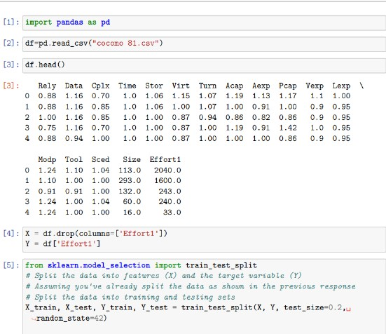
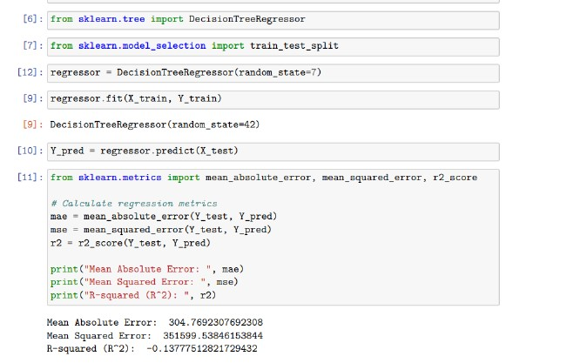
Implementation of decision tree using COCOMO dataset

Slide 20
Result
We present the outcomes of existing machine learning model . We are tried to evaluate its accuracy , efficiency and relative errors . We compare its performance with traditional methods and existing other methods , showcasing how it outperforms them . We share key findings and insights from our evaluation.
From this we are saying that we can do more enhancement of decision tree implementation to get more accuracy and efficiency for software estimation.

Slide 21
Conclusion
In conclusion , We summarize the main findings from our presentation. We underscore the transformative potential of machine learning, specifically decision trees, in elevating software cost estimation. We highlight how this innovation can lead to more effective project management and resource allocation.
This project can estimate the effort and cost using decision tree in machine learning. The estimating is done using enhancement of decision tree in machine learning technique using COCOMO 81 dataset. From this , we conclude that the decision tree in machine learning model can be used with promising results to predict software effort.

Slide 22
References
Software Engineering | COCOMO Model – GeeksforGeeks
ChatGPT (openai.com)
https://gamma.app/
Machine Learning Models for Software Cost Estimation | IEEE Conference Publication | IEEE Xplore
IEEE Xplore
Wikipedia
https://sci-hub.se/

Slide 23
Thank You!

